Slide 1
TensorFlow tutorial: RNN
Soo Kim
Lawrence Livermore National Laboratories

Slide 2
Outline
RNN cell
Problem statement
Coding
Sources: 모두를 위한 딥러닝 강의: http://hunkim.github.io/ml/ https://github.com/hunkim/DeepLearningZeroToAll/blob/master/lab-12-1-hello-rnn.py

Slide 3


https://github.com/hunkim/DeepLearningZeroToAll/

Slide 4
RNN in TensorFlow
cell = tf.contrib.rnn.BasicRNNCell(num_units=hidden_size)
... (dynamic_rnn vs static_rnn?) outputs, _states = tf.nn.dynamic_rnn(cell, x_data, dtype=tf.float32)
https://github.com/hunkim/DeepLearningZeroToAll/blob/master/lab-12-0-rnn_basics.ipynb
Notes:
Structure of RNN: feed forward loop
Output is going as input of next time step
Define cell: num_units--> define the size of output
Run cell: plug input in and get output.
Difference btw static_rnn(size of time_step: k) and dynamic_rnn(size of time_step:None)

Slide 5
RNN in TensorFlow
cell = tf.contrib.rnn.BasicRNNCell(num_units=hidden_size)
cell = tf.contrib.rnn.BasicLSTMCell(num_units=hidden_size) ... outputs, _states = tf.nn.dynamic_rnn(cell, x_data, dtype=tf.float32)
https://github.com/hunkim/DeepLearningZeroToAll/blob/master/lab-12-0-rnn_basics.ipynb
Notes:
We can simply change ”cell” as other types of RNN (such as GRU, LSTM etc.)
Do not need to dynamic_rnn statement → easy

Slide 6
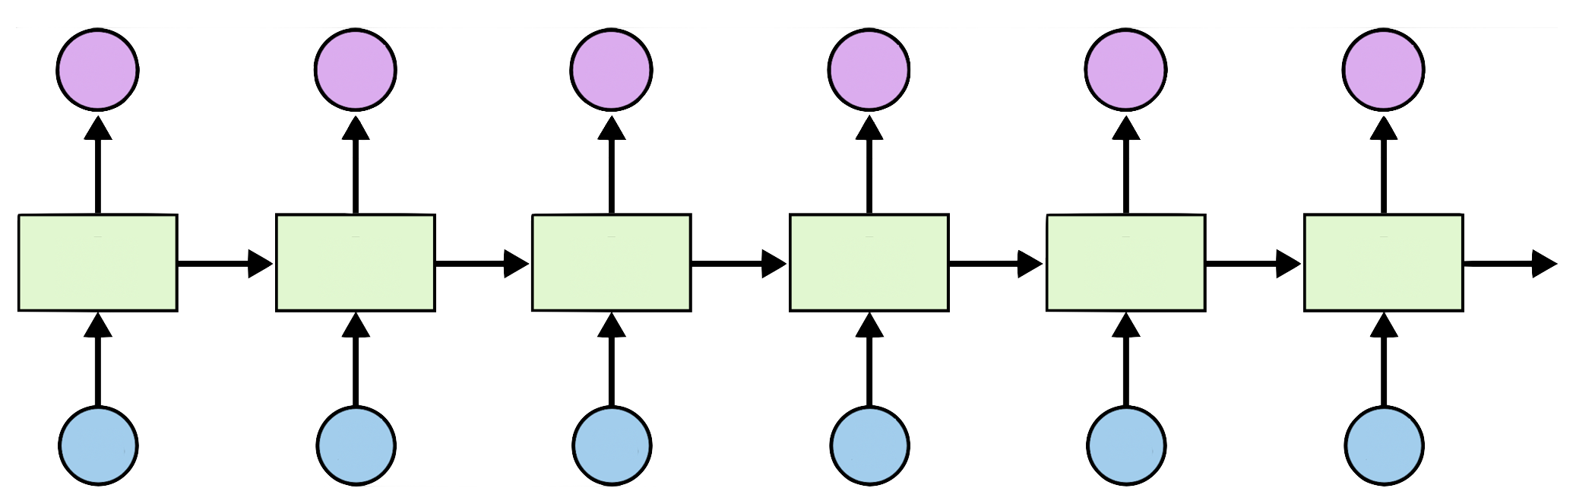
Teach RNN ‘hihello’
i
h
e
l
l
o
h
i
h
e
l
l

Slide 7
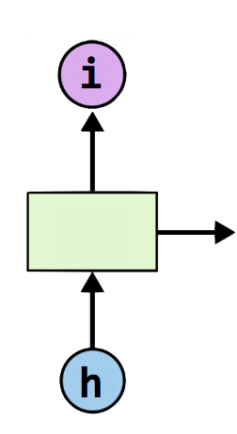
One-hot encoding
text: ‘hihello’
unique chars (vocabulary, voc):
h, i, e, l, o
voc index:
h:0, i:1, e:2, l:3, o:4
[1, 0, 0, 0, 0], # h 0
[0, 1, 0, 0, 0], # i 1
[0, 0, 1, 0, 0], # e 2
[0, 0, 0, 1, 0], # l 3
[0, 0, 0, 0, 1], # o 4

Slide 8
Teach RNN ‘hihello’
[1, 0, 0, 0, 0], # h 0
[0, 1, 0, 0, 0], # i 1
[0, 0, 1, 0, 0], # e 2
[0, 0, 0, 1, 0], # l 3
[0, 0, 0, 0, 1], # o 4
Input dimension?
Output(hidden state) dimension?
Timesteps?
Batch-size?
[0, 1, 0, 0, 0]
[1, 0, 0, 0, 0]
[0, 1, 0, 0, 0]
[0, 1, 0, 0, 0]
[0, 1, 0, 0, 0]
[0, 0, 0, 0, 1]
i
h
e
l
l
o
h
i
h
e
l
l
[1, 0, 0, 0, 0]
[0, 1, 0, 0, 0]
[1, 0, 0, 0, 0]
[0, 1, 0, 0, 0]
[0, 1, 0, 0, 0]
[0, 1, 0, 0, 0]
Notes:
Input dimension? 5
Output(hidden state) dimension? 5
Timesteps? 6
Batch-size? 1

Slide 9
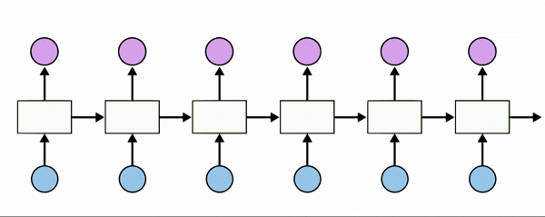
Teach RNN ‘hihello’
[1, 0, 0, 0, 0], # h 0
[0, 1, 0, 0, 0], # i 1
[0, 0, 1, 0, 0], # e 2
[0, 0, 0, 1, 0], # l 3
[0, 0, 0, 0, 1], # o 4

Slide 10
Creating rnn cell
# RNN model
rnn_cell = rnn_cell.BasicRNNCell(rnn_size)
rnn_cell = rnn_cell. BasicLSTMCell(rnn_size)
rnn_cell = rnn_cell. GRUCell(rnn_size)

Slide 11
Creating rnn cell
# RNN model
rnn_cell = rnn_cell.BasicRNNCell(rnn_size)
rnn_cell = rnn_cell. BasicLSTMCell(rnn_size)
rnn_cell = rnn_cell. GRUCell(rnn_size)

Slide 12


Execute RNN
hidden_rnn_size
# RNN model
rnn_cell = rnn_cell.BasicRNNCell(rnn_size)
outputs, _states = tf.nn.dynamic_rnn(
rnn_cell,
X,
initial_state=initial_state,
dtype=tf.float32)

Slide 13
RNN parameters
hidden_size = 5 # output from the LSTM
input_dim = 5 # one-hot size
batch_size = 1 # one sentence
sequence_length = 6 # |ihello| == 6
https://github.com/hunkim/DeepLearningZeroToAll/blob/master/lab-12-1-hello-rnn.py

Slide 14
Data creation
idx2char = ['h', 'i', 'e', 'l', 'o'] # h=0, i=1, e=2, l=3, o=4
x_data = [[0, 1, 0, 2, 3, 3]] # hihell
x_one_hot = [[[1, 0, 0, 0, 0], # h 0
[0, 1, 0, 0, 0], # i 1
[1, 0, 0, 0, 0], # h 0
[0, 0, 1, 0, 0], # e 2
[0, 0, 0, 1, 0], # l 3
[0, 0, 0, 1, 0]]] # l 3
y_data = [[1, 0, 2, 3, 3, 4]] # ihello
X = tf.placeholder(tf.float32,
[None, sequence_length, input_dim]) # X one-hot
Y = tf.placeholder(tf.int32, [None, sequence_length]) # Y label
https://github.com/hunkim/DeepLearningZeroToAll/blob/master/lab-12-1-hello-rnn.py

Slide 15
Feed to RNN
x_one_hot = [[[1, 0, 0, 0, 0], # h 0
[0, 1, 0, 0, 0], # i 1
[1, 0, 0, 0, 0], # h 0
[0, 0, 1, 0, 0], # e 2
[0, 0, 0, 1, 0], # l 3
[0, 0, 0, 1, 0]]] # l 3
y_data = [[1, 0, 2, 3, 3, 4]] # ihello
X = tf.placeholder(
tf.float32, [None, sequence_length, hidden_size]) # X one-hot
Y = tf.placeholder(tf.int32, [None, sequence_length]) # Y label
cell = tf.contrib.rnn.BasicLSTMCell(num_units=hidden_size, state_is_tuple=True)
initial_state = cell.zero_state(batch_size, tf.float32)
outputs, _states = tf.nn.dynamic_rnn(
cell, X, initial_state=initial_state, dtype=tf.float32)
https://github.com/hunkim/DeepLearningZeroToAll/blob/master/lab-12-1-hello-rnn.py

Slide 16
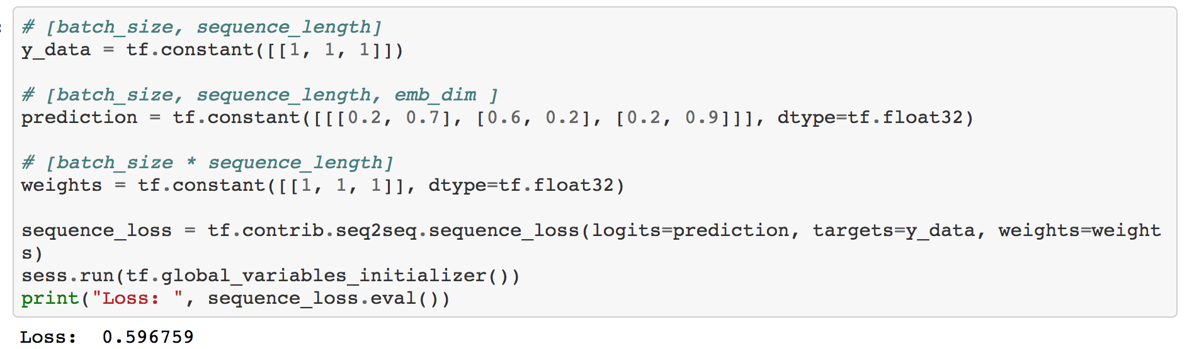
Cost: sequence_loss
https://github.com/hunkim/DeepLearningZeroToAll/blob/master/lab-12-0-rnn_basics.ipynb

Slide 17
Cost: sequence_loss
# [batch_size, sequence_length] y_data = tf.constant([[1, 1, 1]]) # [batch_size, sequence_length, emb_dim ] prediction1 = tf.constant([[[0.3, 0.7], [0.3, 0.7], [0.3, 0.7]]], dtype=tf.float32) prediction2 = tf.constant([[[0.1, 0.9], [0.1, 0.9], [0.1, 0.9]]], dtype=tf.float32) # [batch_size * sequence_length] weights = tf.constant([[1, 1, 1]], dtype=tf.float32) sequence_loss1 = tf.contrib.seq2seq.sequence_loss(prediction1, y_data, weights) sequence_loss2 = tf.contrib.seq2seq.sequence_loss(prediction2, y_data, weights) sess.run(tf.global_variables_initializer()) print("Loss1: ", sequence_loss1.eval(), "Loss2: ", sequence_loss2.eval())
Loss1: 0.513015
Loss2: 0.371101

Slide 18
Cost: sequence_loss
outputs, _states = tf.nn.dynamic_rnn(
cell, X, initial_state=initial_state, dtype=tf.float32)
weights = tf.ones([batch_size, sequence_length])
sequence_loss = tf.contrib.seq2seq.sequence_loss(
logits=outputs, targets=Y, weights=weights)
loss = tf.reduce_mean(sequence_loss)
train = tf.train.AdamOptimizer(learning_rate=0.1).minimize(loss)
https://github.com/hunkim/DeepLearningZeroToAll/blob/master/lab-12-1-hello-rnn.py

Slide 19
Training
prediction = tf.argmax(outputs, axis=2)
with tf.Session() as sess:
sess.run(tf.global_variables_initializer())
for i in range(2000):
l, _ = sess.run([loss, train], feed_dict={X: x_one_hot, Y: y_data})
result = sess.run(prediction, feed_dict={X: x_one_hot})
print(i, "loss:", l, "prediction: ", result, "true Y: ", y_data)
# print char using dic
result_str = [idx2char[c] for c in np.squeeze(result)]
print("\tPrediction str: ", ''.join(result_str))
https://github.com/hunkim/DeepLearningZeroToAll/blob/master/lab-12-1-hello-rnn.py

Slide 20
Results
prediction = tf.argmax(outputs, axis=2)
with tf.Session() as sess:
sess.run(tf.global_variables_initializer())
for i in range(2000):
l, _ = sess.run([loss, train], feed_dict={X: x_one_hot, Y: y_data})
result = sess.run(prediction, feed_dict={X: x_one_hot})
print(i, "loss:", l, "prediction: ", result, "true Y: ", y_data)
# print char using dic
result_str = [idx2char[c] for c in np.squeeze(result)]
print("\tPrediction str: ", ''.join(result_str))
0 loss: 1.55474 prediction: [[3 3 3 3 4 4]] true Y: [[1, 0, 2, 3, 3, 4]] Prediction str: lllloo
1 loss: 1.55081 prediction: [[3 3 3 3 4 4]] true Y: [[1, 0, 2, 3, 3, 4]] Prediction str: lllloo
2 loss: 1.54704 prediction: [[3 3 3 3 4 4]] true Y: [[1, 0, 2, 3, 3, 4]] Prediction str: lllloo
3 loss: 1.54342 prediction: [[3 3 3 3 4 4]] true Y: [[1, 0, 2, 3, 3, 4]] Prediction str: lllloo
...
1998 loss: 0.75305 prediction: [[1 0 2 3 3 4]] true Y: [[1, 0, 2, 3, 3, 4]] Prediction str: ihello
1999 loss: 0.752973 prediction: [[1 0 2 3 3 4]] true Y: [[1, 0, 2, 3, 3, 4]] Prediction str: ihello
https://github.com/hunkim/DeepLearningZeroToAll/blob/master/lab-12-1-hello-rnn.py

